Slide 1
Monetary Policy Report
January 2020
    In focus Supply and spare capacity

Slide 2
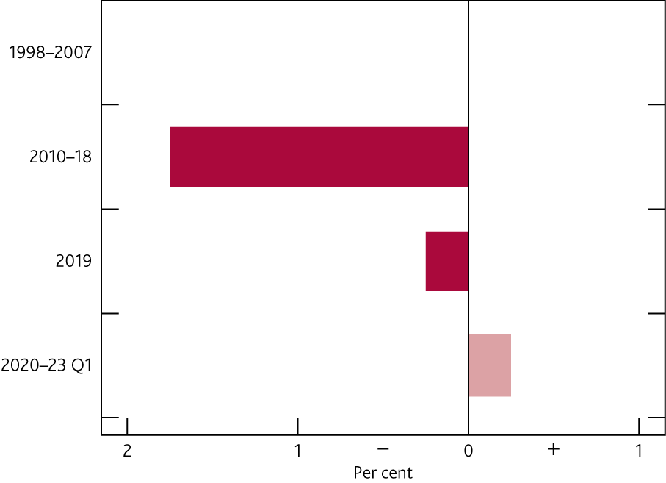
  Chart 4.1 Output was estimated to be below potential supply in 2019
    Difference between output and estimated potential supply^{(a)}
(a) Average per cent of potential GDP. A negative figure implies output is below potential — ie there is excess supply — and a positive figure that it is above — ie there is excess demand. Shaded bar is the MPC’s forecast. For further information on MPC projections, see Table 1.A.

Slide 3
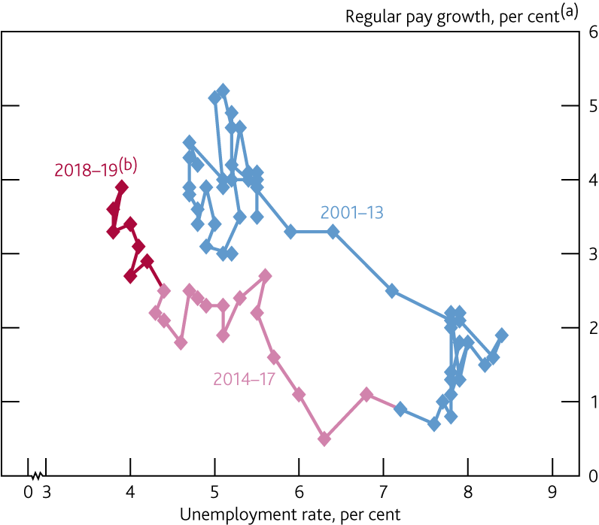
  Chart 4.2 Wage growth has picked up as the unemployment rate has fallen
    Wage Phillips curve: wage growth and unemployment
(a) Whole-economy regular pay. Three-month average growth on the same period a year earlier.
(b) Diamond for 2019 Q4 shows Bank staff’s projections, based on data to November.

Slide 4
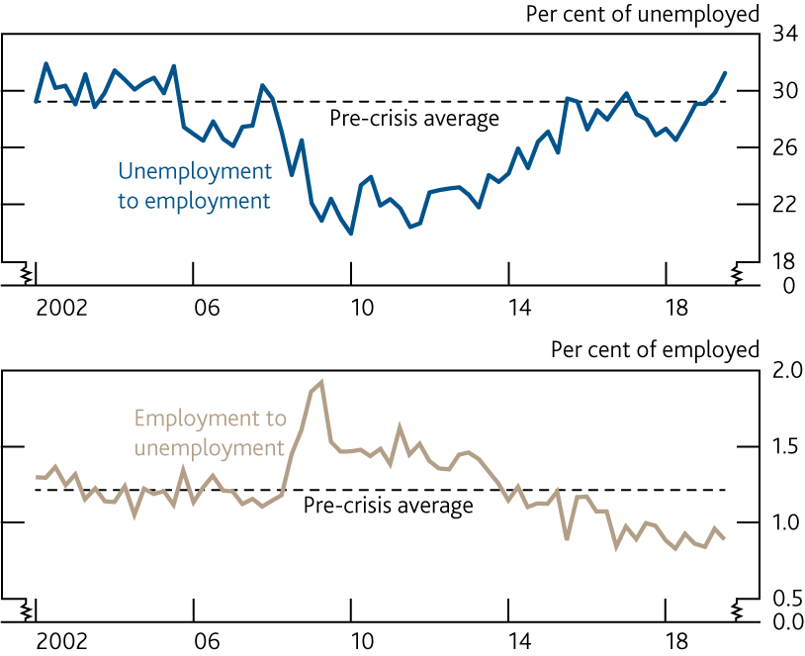
  Chart 4.3 The job-finding rate has risen while the job destruction rate has remained low
    Flows between employment and unemployment^{(a)}
Sources: ONS and Bank calculations.
(a) Two-quarter flows. Flows between employment and unemployment are based on total employment and unemployment of people aged 16–64. Dashed lines are averages from 2002 to 2007.

Slide 5
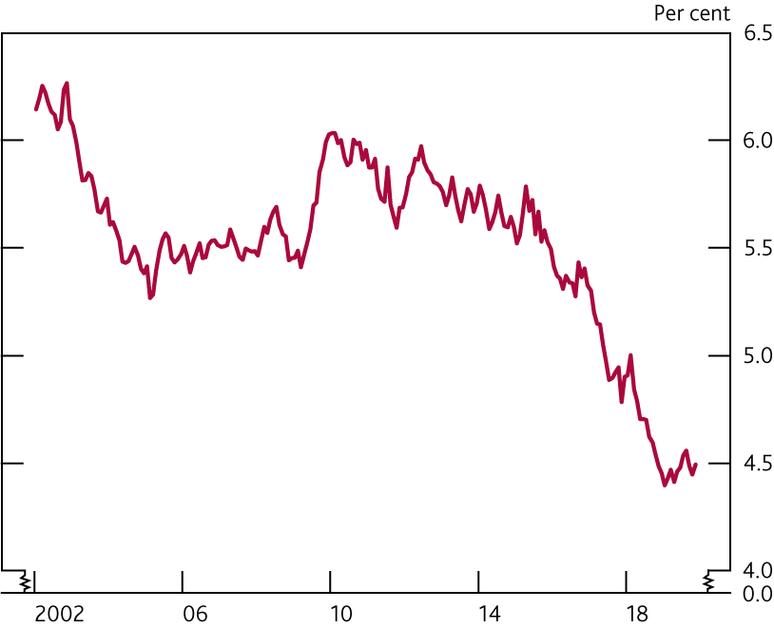
  Chart 4.4 The proportion of people not currently looking for work, but who would like a job, has been stable over 2019
  at a low level
    Marginal attachment ratio^{(a)}
Sources: ONS and Bank calculations.
(a) Number of those aged 16–64 who say they are not in work or not actively looking for work but would like a job, as a percentage of the 16–64 population.

Slide 6
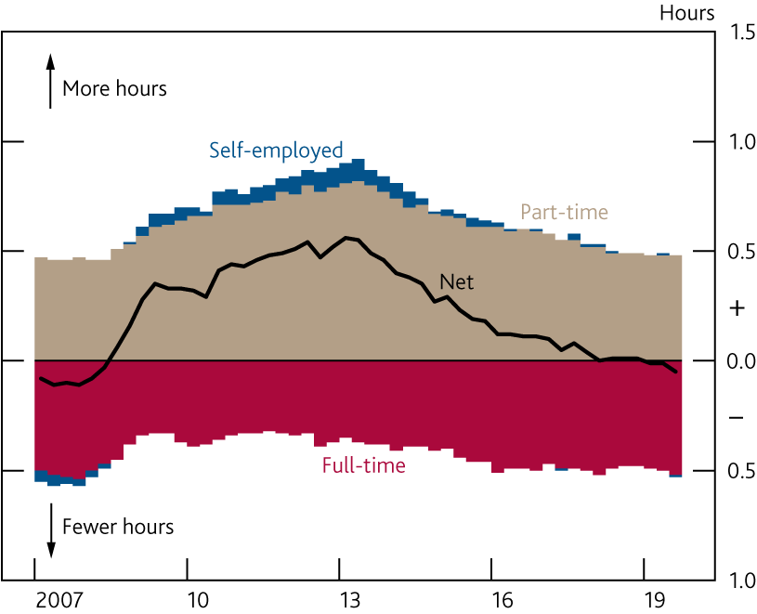
  Chart 4.5 People no longer wish to work longer hours, on average
    Net additional desired hours^{(a)}
Sources: Labour Force Survey and Bank calculations.
(a) Number of net additional hours that the currently employed report they would like to work, on average, per week.

Slide 7
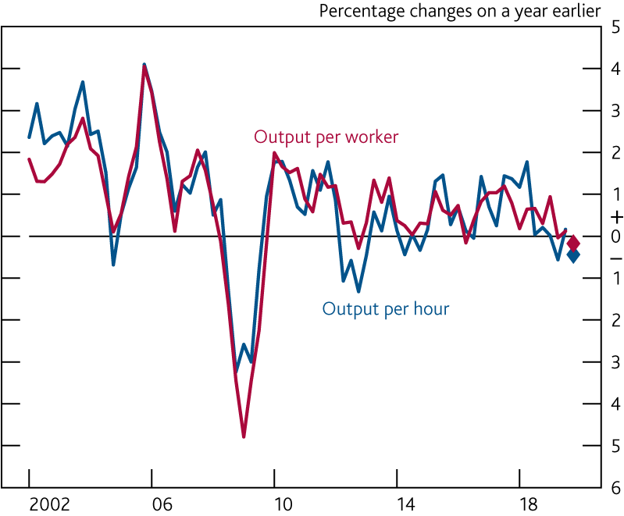
  Chart 4.6 Productivity growth is expected to be below zero
  in the year to 2019 Q4
    Measures of labour productivity^{(a)}
Sources: ONS and Bank calculations.
(a) Output is based on the backcast for the final estimate of GDP. Diamonds show Bank staff’s projections for 2019 Q4, based on data to November.

Slide 8
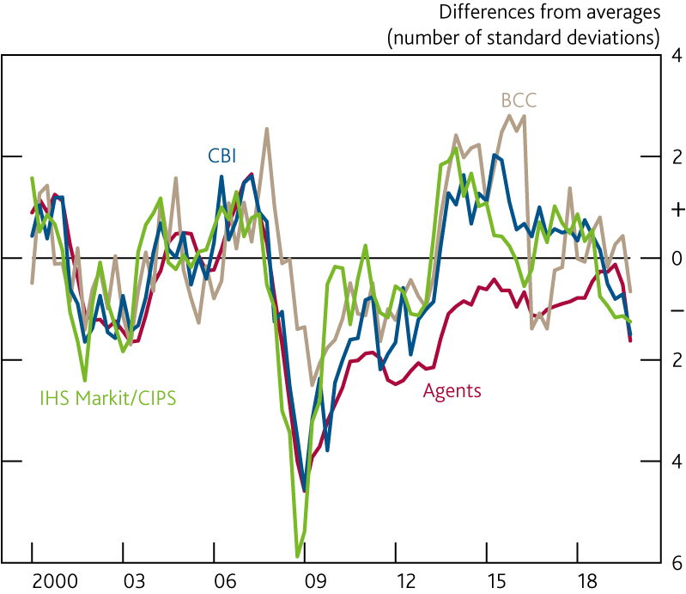
  Chart 4.7 Survey measures of capacity utilisation have fallen over 2019
    Survey indicators of capacity utilisation^{(a)}
Sources: Bank of England, BCC, CBI, CBI/PwC, IHS Markit/CIPS, ONS and Bank calculations.
(a) Differences from averages between 2000 and 2007. Measures are from the Bank’s Agents, the BCC (non-services and services), the CBI (manufacturing — capacity; financial services, business/consumer/professional services and distributive trade — business relative to normal) and IHS Markit/CIPS (manufacturing — backlogs; services — outstanding business). Sectors are weighted using shares in gross value added. The BCC data are not seasonally adjusted.

Slide 9
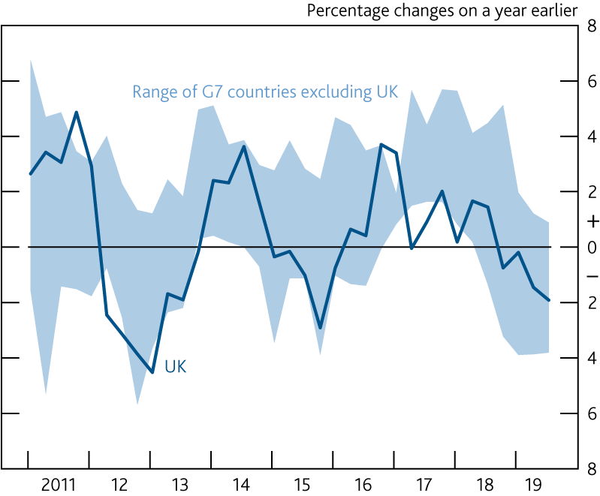
  Chart 4.8 Productivity growth in the manufacturing sector has fallen in the G7 economies
    Manufacturing sector hourly labour productivity in the G7 countries^{(a)}
Sources: Eikon from Refinitiv, Eurostat, OECD, ONS and Bank calculations.
(a) Manufacturing productivity is calculated as gross value added divided by hours worked.

Slide 10
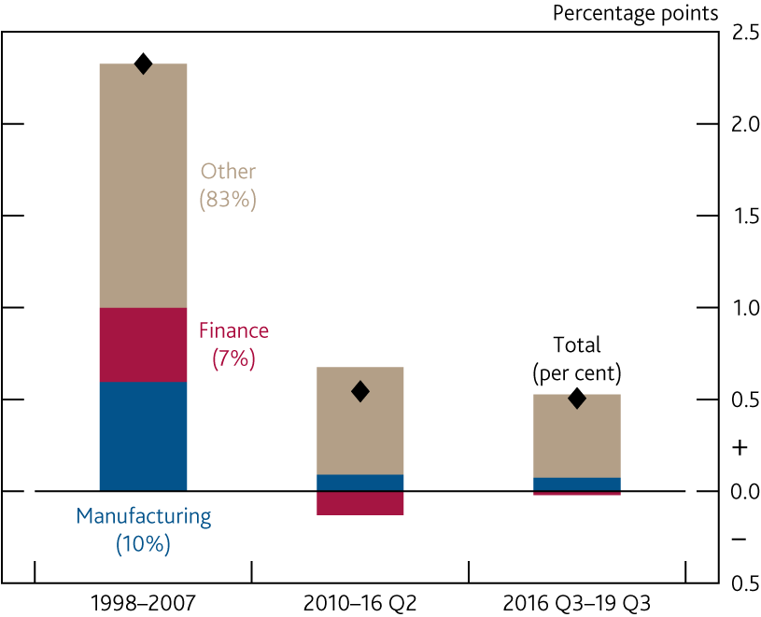
  Chart 4.9 Productivity growth has been weak in manufacturing and finance
    Contributions to hourly labour productivity growth^{(a)}
Sources: ONS and Bank calculations.
(a) Sectoral output per hour is calculated as gross value added (GVA) divided by hours worked. Figures in parentheses are weights in GVA. Other is calculated as a residual and includes other sectors and allocation effects.

Slide 11
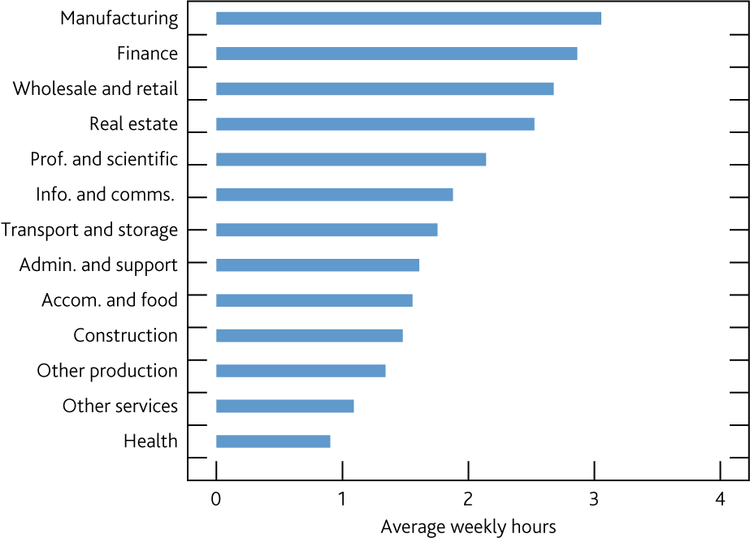
  Chart 4.10 The manufacturing and finance sectors have spent the most time planning for Brexit
    CFO time spent on Brexit planning by sector^{(a)}
Sources: DMP Survey and Bank calculations.
(a) Question: ‘On average, how many hours a week is the CFO of your business spending on preparing for Brexit at the moment?’. Respondents are asked to choose between ‘None’, ‘Up to 1 hour’, ‘1 to 5 hours’, ‘6 to 10 hours’, ‘More than 10 hours’ and ‘Don’t know’. Responses collected between August and October 2019. Point estimates are constructed by using values of 0, 0.5, 3, 8 and 15 for the respective categories.

Slide 12
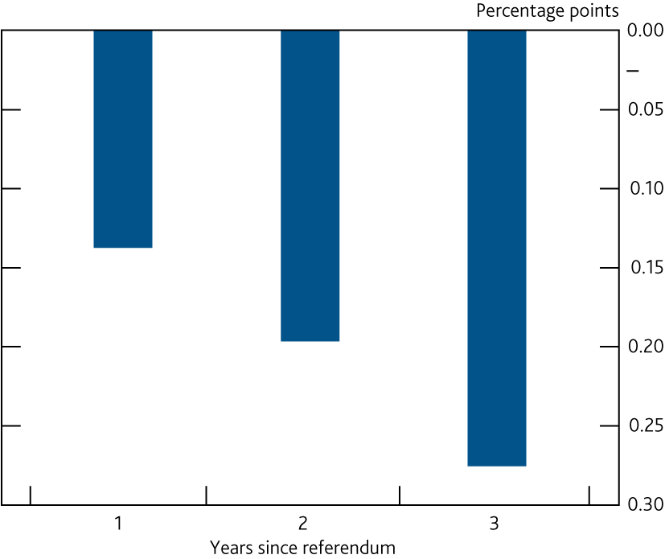
  Chart 4.11 Brexit planning has increasingly weighed on productivity growth since the referendum
    Impact of Brexit planning on labour productivity growth^{(a)}
Sources: Bureau van Dijk, DMP Survey and Bank calculations.
(a) Bank staff estimates based on DMP Survey responses and company accounts data. Brexit planning comprises time (CFO and CEO hours) and resources spent planning for Brexit. Unweighted regression based estimates are scaled to be consistent with aggregate effects estimated by Bloom et al (2019).

Slide 13
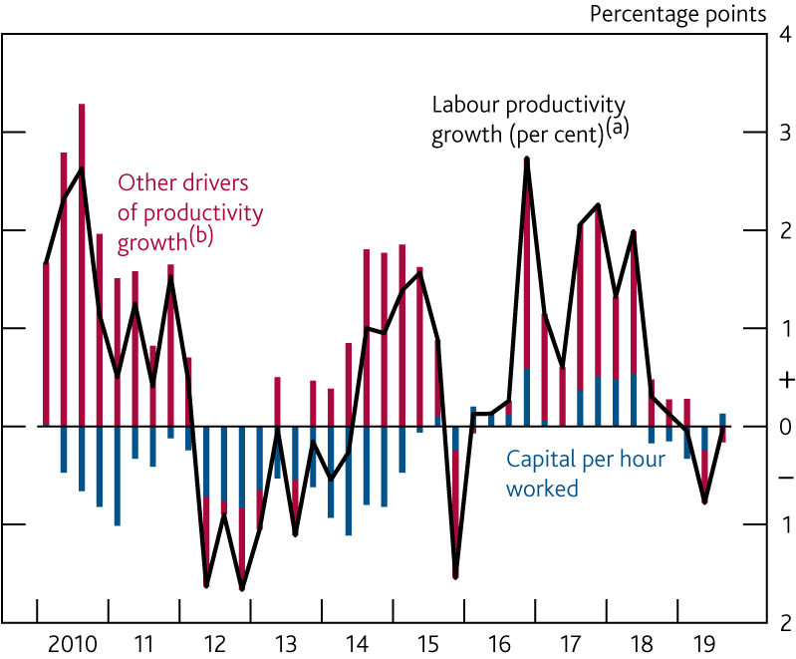
  Chart 4.12 Capital deepening has weighed on productivity growth since the crisis, on average
    Contributions to four-quarter growth in hourly labour productivity
Sources: ONS and Bank calculations.
(a) Market sector output per hour.
(b) Calculated as a residual.

Slide 14
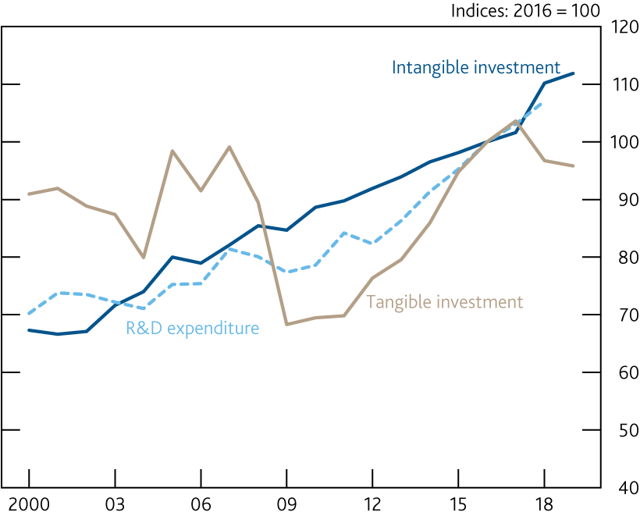
  Chart 4.13 Research and development expenditure has increased
    Expenditure on tangible and intangible investment and research and development^{(a)}
Sources: ONS and Bank calculations.
(a) Annual averages. Data for R&D expenditure are to 2018. Data for tangible and intangible investment are to 2019 Q3. 2019 Q4 is assumed to be equal to an average of Q1–Q3.

Slide 15
Tables

Slide 16
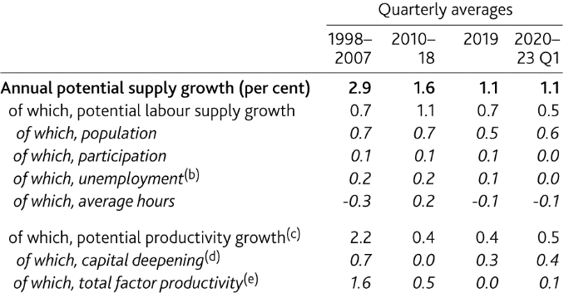
  Table 4.A Potential supply growth has slowed and is expected to remain subdued
    Decomposition of estimated potential supply growth^{(a)}
Sources: ONS and Bank calculations.
(a) Average percentage point contributions to annual growth unless otherwise specified. Contributions may not sum to the total due to rounding.
(b) Positive numbers indicate that a fall in the equilibrium unemployment rate has increased potential labour supply.
(c) Based on a growth-accounting framework using a constant returns to scale Cobb-Douglas production function, with total output to capital elasticity of ⅓.
(d) Capital deepening refers to growth in capital services per person-hour.
(e) Total factor productivity growth refers to improvements in the efficiency with which both capital and labour are used to produce output. Calculated as a residual.

